Slide 1

A Century of the Danceability of Music
Velveeta: Haley Peterson, Emily Wuenstel, Collin Page, Drew Miller
Northwestern University Data Science Bootcamp – Project 1

Slide 2
Thesis and Conclusion
Thesis: The “danceability” of music is correlated to measurable qualities of the music. Using data from 1921-2021, there are both positive and negative correlations to measurable attributes of a song that impact its “danceability”.
Conclusion: Our analysis provides data-driven evidence that, over the past 100 years:
1) Across decades, there has been a steady increase of danceability since the Post-War years, with a decline of acousticness and rise in energy (as well as loudness and tempo).
2) As indicated by a song’s qualities, from the past 75 years, acousticness has the highest correlation to a song’s danceability, followed closely by energy and loudness;
3) Among qualities from the past 75 years, acousticness and energy had the highest correlation to one another, although strongly negative, while the next closest correlation of qualities was a strong positive relationship between energy and loudness; and
4) There are geographic influences, as indicated by genre that impact a song’s danceability when compared on a global setting. While widely known genres (Pop, Rock, Punk) are known to be danceable, country-specific genres reach audiences in their own manner, catapulting them to the most danceable title.

Slide 3
Definitions
Acousticness: “A confidence measure from 0.0 to 1.0 of whether the track is acoustic. 1.0 represents high confidence the track is acoustic.”
Danceability: “Describes how suitable a track is for dancing based on a combination of musical elements including tempo, rhythm stability, beat strength, and overall regularity. A value of 0.0 is least danceable and 1.0 is most danceable.”
Liveliness: “Detects the presence of an audience in the recording. Higher liveness values represent an increased probability that the track was performed live. A value above 0.8 provides strong likelihood that the track is live.”
Loudness: “The overall loudness of a track in decibels (dB). Loudness values are averaged across the entire track and are useful for comparing relative loudness of tracks. Loudness is the quality of a sound that is the primary psychological correlate of physical strength (amplitude). Values typical range between -60 and 0 db.”

Slide 4
Definitions (cont.)
Instrumentalness: “Predicts whether a track contains no vocals. “Ooh” and “aah” sounds are treated as instrumental in this context. Rap or spoken word tracks are clearly “vocal”. The closer the instrumentalness value is to 1.0, the greater likelihood the track contains no vocal content. Values above 0.5 are intended to represent instrumental tracks, but confidence is higher as the value approaches 1.0.”
Speechiness: “Detects the presence of spoken words in a track. The more exclusively speech-like the recording (e.g., talk show, audio book, poetry), the closer to 1.0 the attribute value. Values above 0.66 describe tracks that are probably made entirely of spoken words. Values between 0.33 and 0.66 describe tracks that may contain both music and speech, either in sections or layered, including such cases as rap music. Values below 0.33 most likely represent music and other non-speech-like tracks.”
Tempo: “The overall estimated tempo of a track in beats per minute (BPM). In musical terminology, tempo is the speed or pace of a given piece and derives directly from the average beat duration.”
Valence: “A measure from 0.0 to 1.0 describing the musical positiveness conveyed by a track. Tracks with high valence sound more positive (e.g., happy, cheerful, euphoric), while tracks with low valence sound more negative (e.g., sad, depressed, angry).

Slide 5
Project Overview & Methodology
Based on Spotify data for songs from 1921-2021, we investigated music’s “danceability” (see Definitions) over the past century. Incorporating Python, Pandas, Matplotlib, Jupyter Notebook and APIs, our project:
1) plots the danceability and qualities of songs over time to identify whether temporal trends exist;
2) evaluates qualities of music to test their correlative impact on a song’s danceability;
3) cross-references individual quality’s correlation to one another, independently of danceability; and
4) compares music by genres to identify geographical origins/genre types’ danceability.

Slide 6
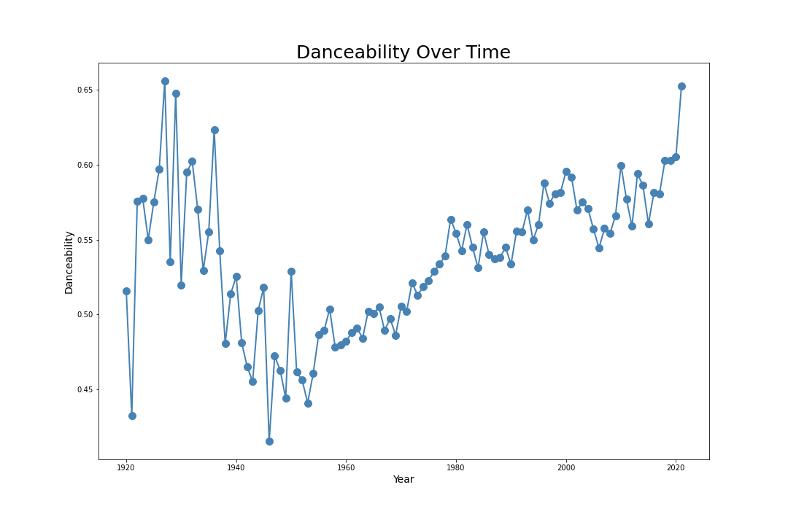
A Century of Danceability

Slide 7
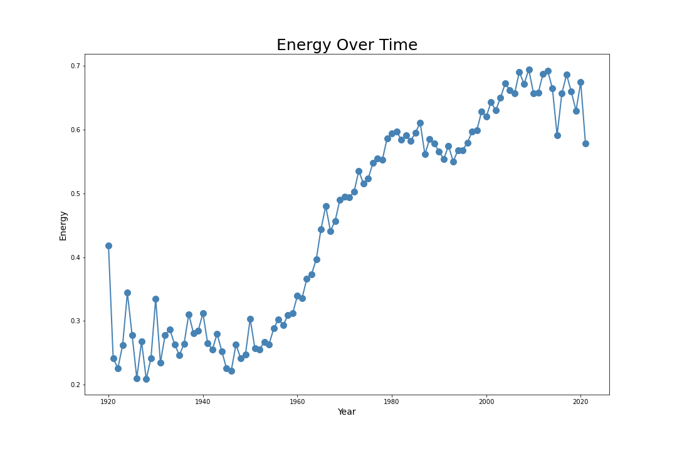
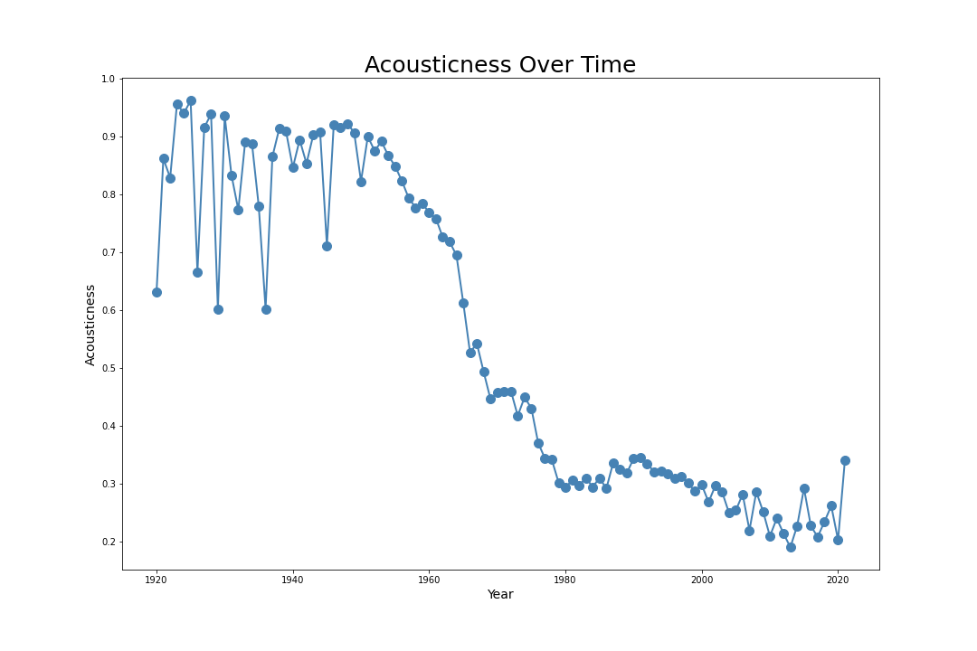
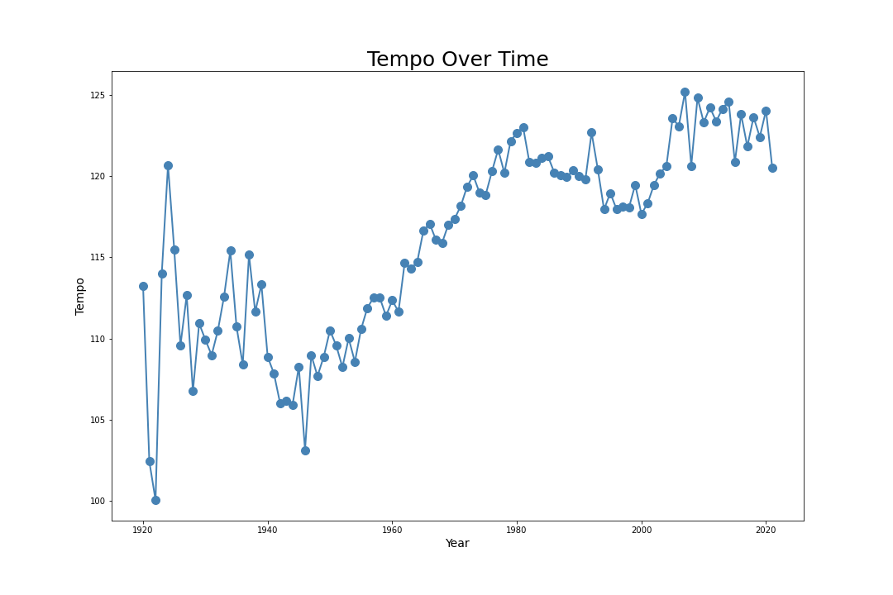
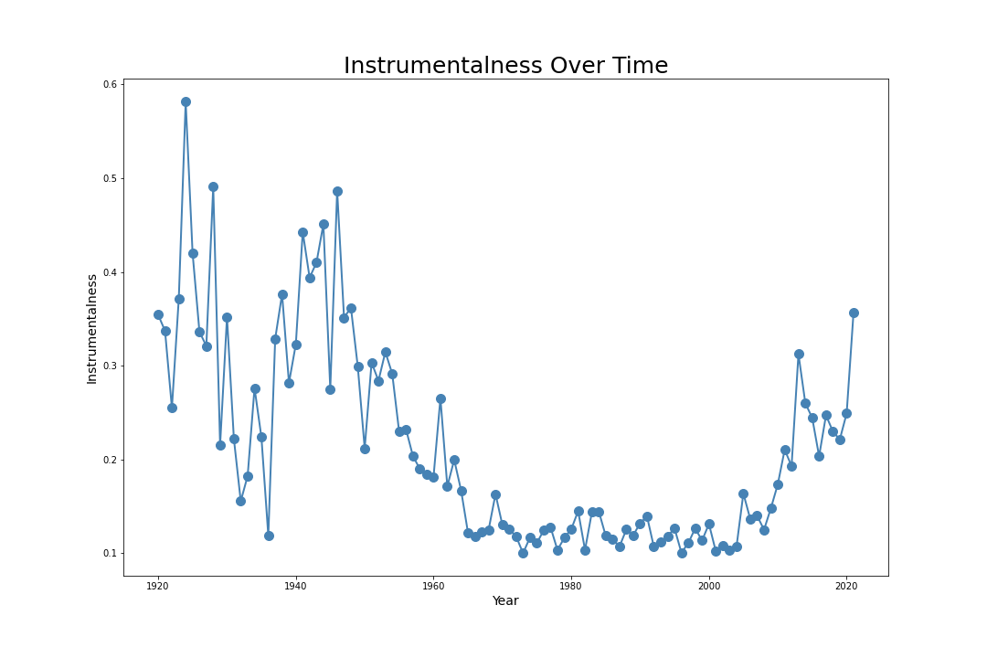
Danceability over Time
Clear visual trends in both the positive and negative directions
Very clear volatility in the first several decades

Slide 8
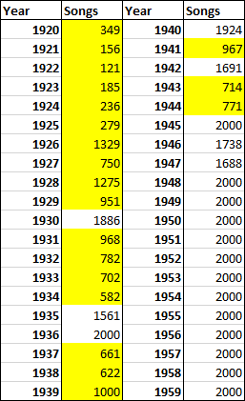
Data Set Evaluation
Data includes 176,000 songs from the past 100 years
Data from 1921-1944 had disparate volume of songs
Data from 2021 were incomplete
Of the 3,233 genres, some were deemed not applicable for analysis

Slide 9
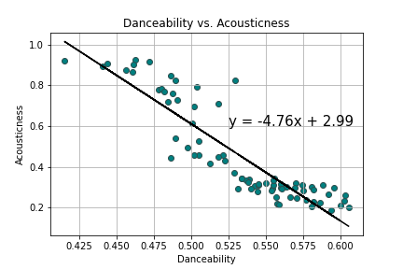
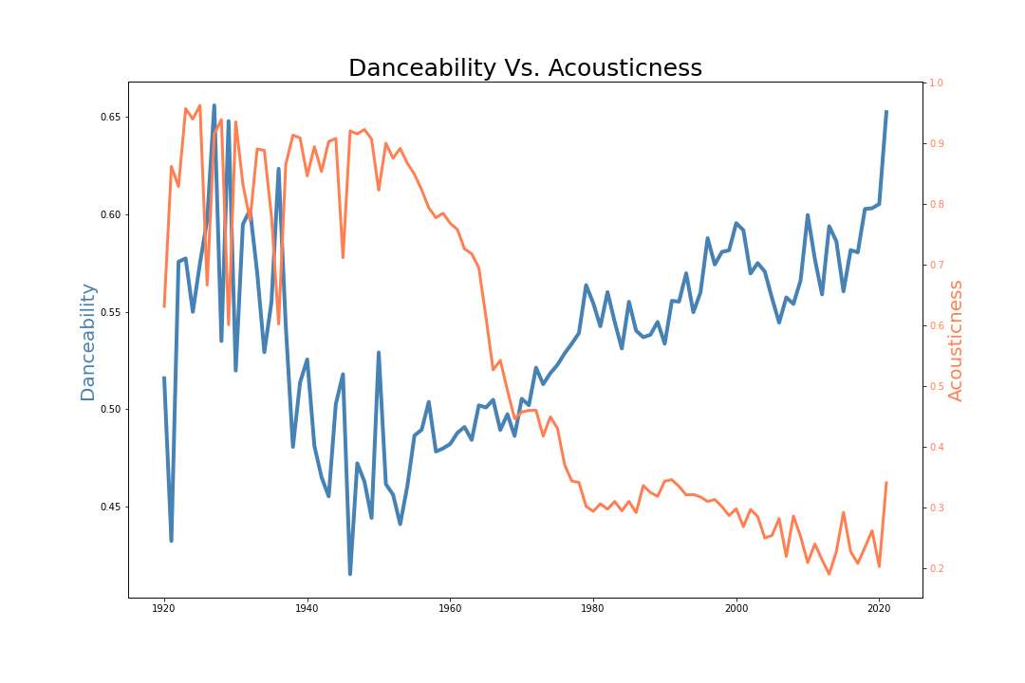
What musical qualities have the biggest impact on a song’s danceability?
Danceability is negatively correlated with Acousticness with a r-squared value of 0.8043

Slide 10
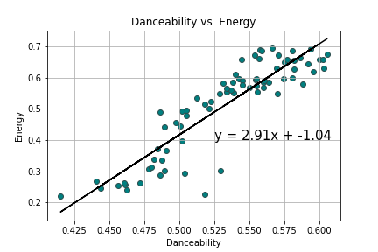
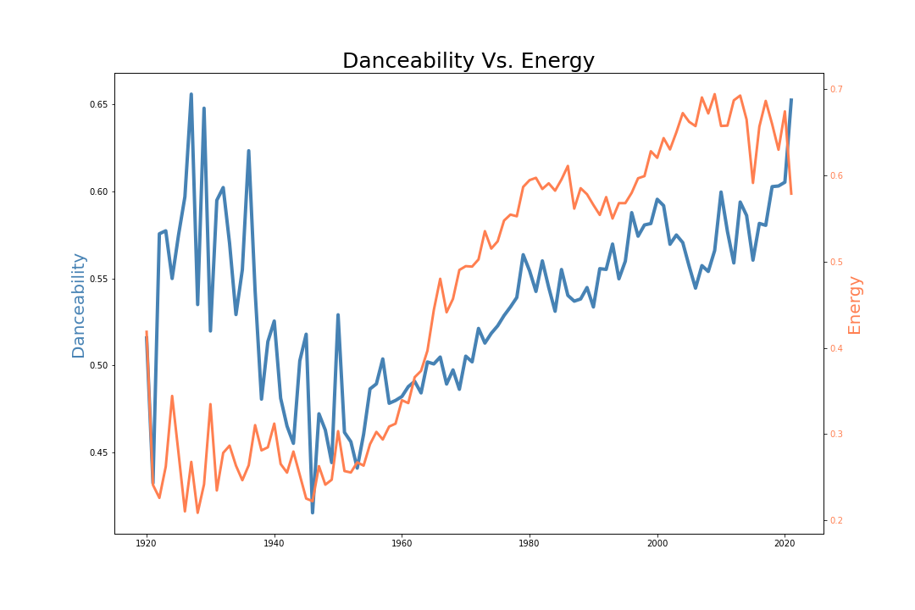
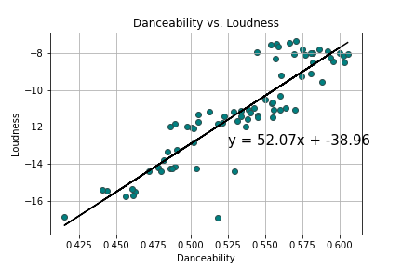
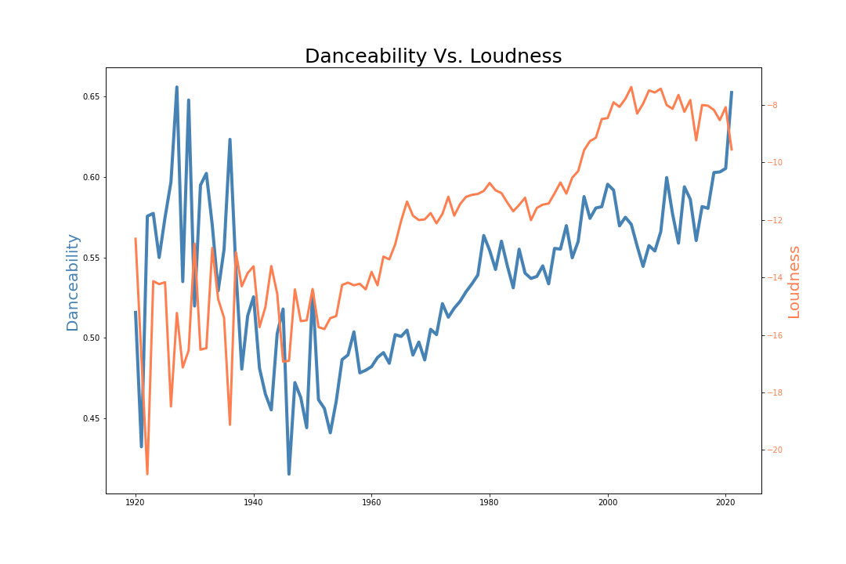
What musical qualities have the biggest impact on a song’s danceability?
Danceability is positively correlated with:
Energy has a r-squared: 0.7937
Loudness has a r-squared: 0.7883

Slide 11
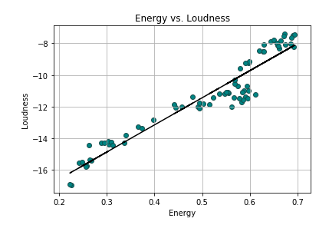
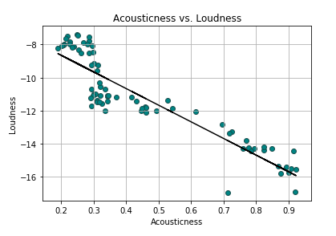
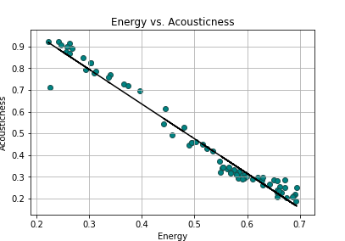
Is there a correlation between the musical qualities that impact danceability?
Main indicators of a song’s danceability are Acousticness and Energy
Additionally, Loudness appeared to have correlation to both Energy and Acousticness

Slide 12












Genres, Danceability, and Location
Where should you travel if you want to dance?
Areas of Interest
Australia
Brazil
UK (Britain)
Germany
France
Sweden
Spain
Norway
Scotland
Russia
Mexico
South Korea
What genre is the most danceable in each Area of Interest?
How does that danceability compare to the most danceable genres in other Areas of Interest?
Are there any genres that are popular across multiple Areas of Interest?

Slide 13
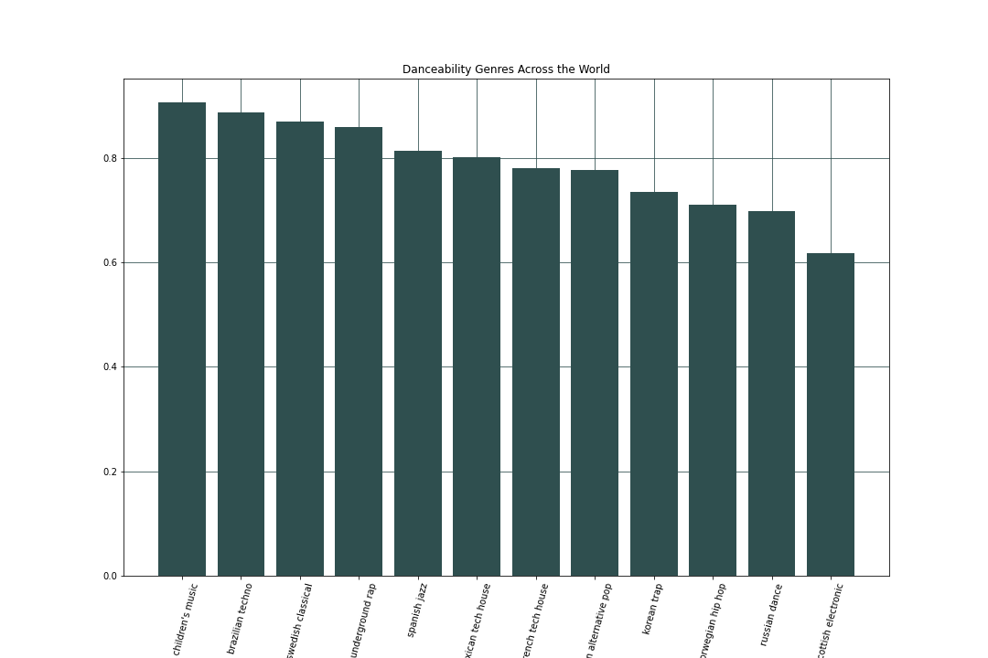
Genres, Danceability, and Location
Where should you travel if you want to dance?
Country | Genre | Danceability
United Kingdom | British Children’s Music | 90.60%
Brazil | Brazilian Techno | 88.80%
Sweden | Swedish Classical | 86.90%
Germany | German Underground Rap | 85.90%
Spain | Spanish Jazz | 81.40%
Mexico | Mexcian Tech House | 80.10%
France | French Tech House | 78.02%
Australia | Australian Alternative Pop | 77.64%
South Korea | Korean Trap | 73.46%
Norway | Norwegian Hip Hop | 71.10%
Russia | Russian Dance | 69.90%
Scotland | Scottish Electronic | 61.84%

Slide 14
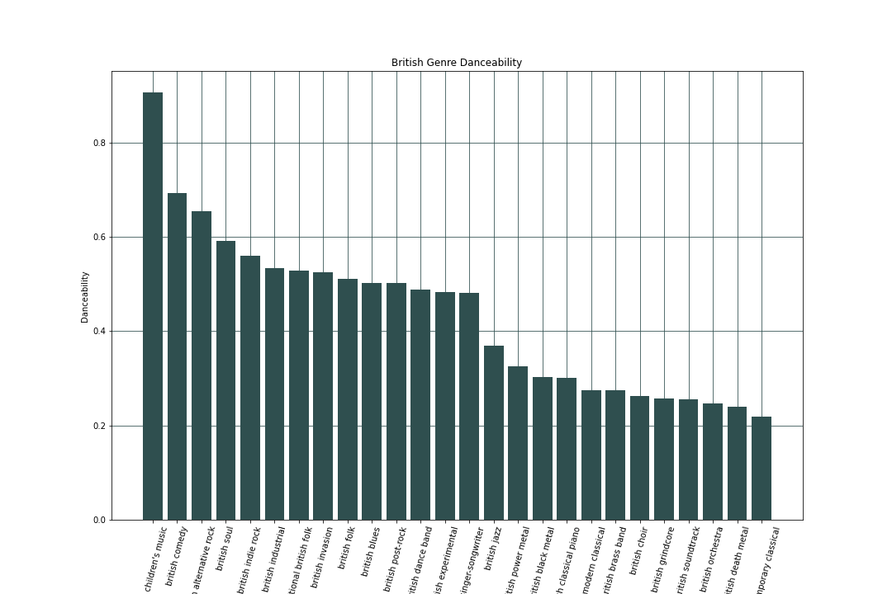
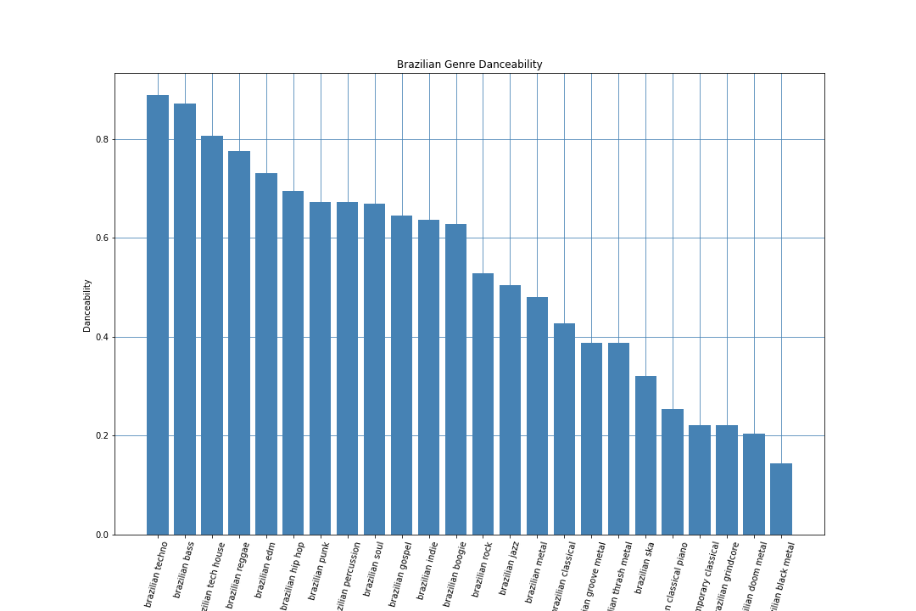
Genres, Danceability, and Location
Where should you travel if you want to dance?
British Children’s Music
British Comedy
British Alternative Rock
British Soul
Brazilian Techno
Brazilian Bass
Brazilian Tech House
Brazilian Reggae

Slide 15
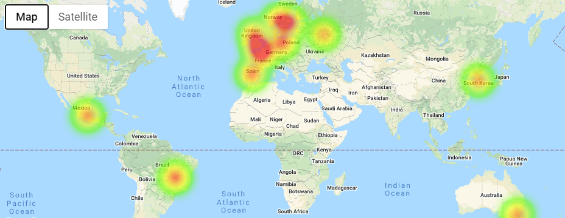
Genres & Danceability
Where should you travel if you want to dance?
The UK has a great concentration of danceable music from many genres.
*This data sample did not include genres specific samples from Africa, Asia, or America

Slide 16
Areas for Further Study
A more robust review of all 3233 Genres, focusing on each Genres danceability individually rather than by regional danceability could provide a more comprehensive view.
Overlaying a yearly timeline view of the Danceability metric in order to see if major historical events had an impact on songs’ Danceability
Looking at 2019 to now in order to determine if COVID19 has had an effect on songs’ attributes

Slide 17




Questions?
Thank you for time

Slide 18
Attributes / Bibliography
Google Maps API (Subsidiary of Alphabet Inc.)
Kaggle Inc. (Subsidiary of Alphabet Inc.)
Spotify Technology S.A.

